Slide 1
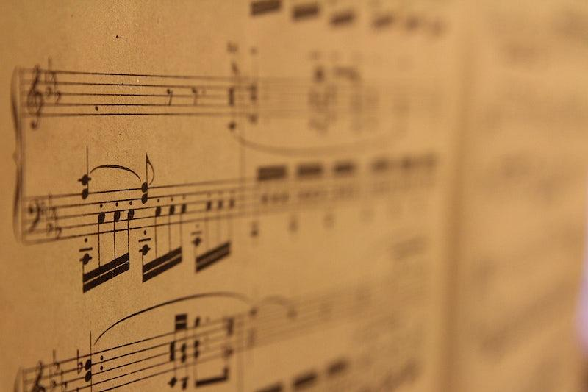
Music, Mind and Technology
Team Idiosingcracies:
Siddik Ayyappa
Shri Vidhathri M
Vivek Mathur

Slide 2
Polyphonic Timbre
Overall timbral mixture in a music signal - sound quality
Essential in characterization/genre classification
Timbre- different descriptors forming a multi dim^{n} timbre space
Polyphonic timbre - multidimensional timbre space
Perceptual nature of polyphonic timbre - less understood

Slide 3
Musicians vs Non-Musicians
Learning music affects cognition, auditory and motor skills
Learning music also affects emotion processing and perception in musicians according to previous studies
Since timbre is a perceptual quality, we have hypothesised that musicians will process timbre differently as compared to non-musicians

Slide 4
Literature review
A study (Alluri,2010) investigated the most salient features of polyphonic timbre perception by investigating the descriptive auditory qualities of music mapping acoustic features to these descriptors
Eight scales were selected in this paper as perceptual descriptors for polyphonic timbre: ‘Colorful-Colorless,’‘Warm-Cold,’ ‘Dark-Bright,’ ‘Acoustic-Synthetic,’ ‘Soft-Hard,’ ‘Strong-Weak,’ Empty-Full,’ and ‘High Energy-Low Energy’

Slide 5
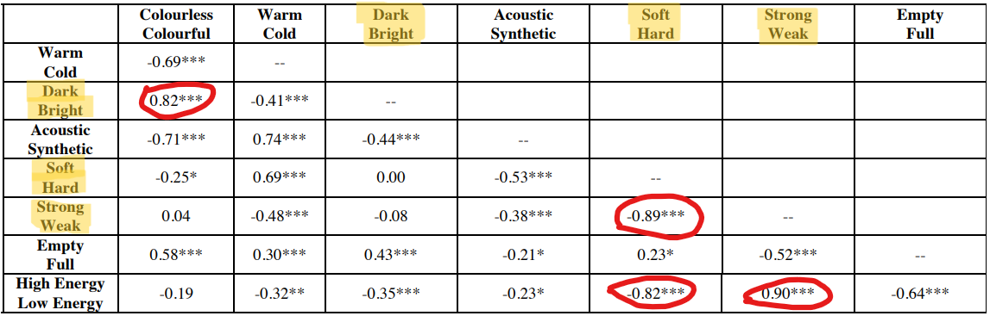
Scales’ selection - warm, acoustic, colour, full, energy

Slide 6
Aim of this project
This project aimed to study the difference between the perception of timbre between musicians and non musicians, with the hypothesis that timbre perception among musicians will be more consistent as compared to nonmusicians.
The acoustic correlation with perceptual descriptors was done separately for musicians and non-musicians to identify which spectral features correspond to the difference in timbre perception of musicians and non-musicians

Slide 7
Dataset
20 excerpts of 1-3 seconds each of Indian origin were used in the study
The excerpts were taken from the supplementary information of a research project related to timbre analysis
The songs were then converted to replayable youtube embedding with blank background to be used in the survey

Slide 8
Data collection
Data collection was done using google forms.
The form contained basic demographic questions such as age and gender. The form also collected the information regarding musical experience of participants.
Any participant with more than 1 year of practicing professional training was considered to be a musician for this study
The music signals were attached to a black screen and uploaded on YouTube and are thereafter embedded in the Form. This allowed free control of the music signals.

Slide 9
Questions in the form
The questions that were asked to the participants were in the form of bipolar scales of the perceptual descriptors
Eg: How warm do you think the song is
Very warm 10 9 8 7 6 5 4 3 2 1 Very cold
Similar questions were asked for all the five descriptors and the audience could choose values on a 10 point scale
Definitions of the characteristics (taken from ChatGPT) were given in the form above each question, for reference of the subject.

Slide 10
Demographics information
The experiment consisted of 46 participants, of which, 21 were musicians, and 25 were non-musicians.
In the non-musicians category, 60\% of the participants were male and 40\% were female. In the musicians' category, 66\% were male, whereas 33\% were female participants.
It was ensured that the audio quality was high enough for the participants to rate with the highest accuracy possible.

Slide 11
Statistical analysis

Slide 12
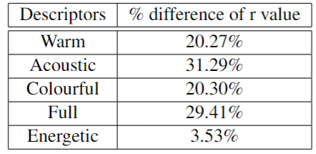
Intersubject correlation

Slide 13
Inter subject correlation
The percentage difference between the mean inter subject correlation of musicians and non-musicians reveal a higher correlation for musicians as compared to non musicians
This indicates that there is a higher consistency/agreement in the perceptual description of timbre amongst musicians than non musicians
This consistency varies across various descriptor, with energy being equally consistent and acoustic/synthetic nature and fullness being highly consistent in musicians

Slide 14
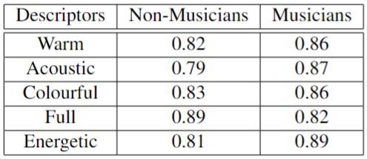
Cronbach Alpha values

Slide 15
Cronbach Alpha
The cronbach alpha values of all the perceptual descriptors(musicians and non musicians) is higher than 0.75, indicating a high reliability and internal consistency in the data
The cronbach alpha values are generally higher for musicians than non musicians, leading to an understanding that the data from musicians has a higher reliability and consistency

Slide 16
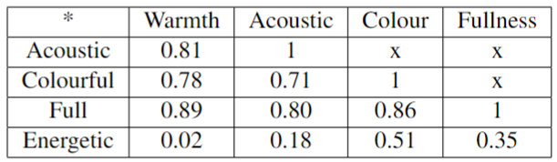
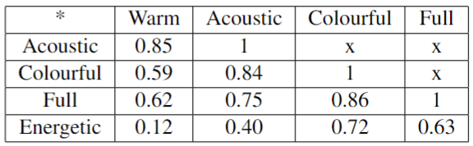
Interscale correlation
Non Musicians
Musicians

Slide 17
Interscale correlation
Many pairs show a high correlation, implying that the descriptors might be related to the same perceptual dimension.
Contrary to previous studies, fullness was highly correlated with three other scales: acoustic, warmth and colour.
Energy resulted in being the least correlated perceptual scale.
Warmth and Acoustic had high mean correlation values, implying that they were referring to the same perceptual dimension
Differences between musicians and non musicians

Slide 18
Feature extraction
Multiple features were extracted from the audio samples for the acoustic feature analysis.
These features were MFCCs,brightness, roughness, entropy, spectral roll-off, bpm, RMS energy, skewness, ZCR, flatness, flux, chroma 12 and sub-band flux.
The feature extraction was done in MATLAB using the MIR Toolbox

Slide 19
Acoustic correlates with perceptual descriptors

Slide 20
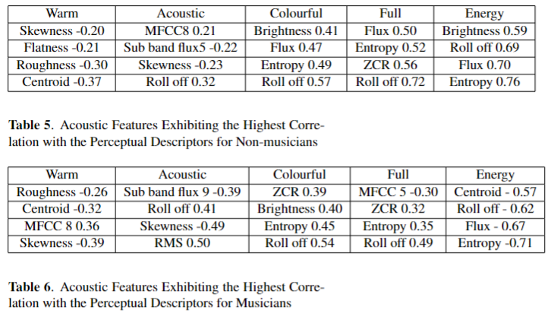

Slide 21
Some inferences from Acoustic correlates
Non musicians correlate warmth with spectral roughness and centroid higher than musicians. Since these represent energy in higher frequency of the spectrum, the centroid being more correlated in non-musicians implies the association of warmth with frequency more than musicians.
The acoustic nature of audio is more associated with skewness in musicians than non-musicians. Skewness represents shape of the spectrum using the direction of outliers. A higher correlation of skewness among musicians indicate a higher capability to identify the shape/quality of sound
Colourfulness is almost similarly related with acoustic features between musicians and non-musicians

Slide 22
Some inferences from Acoustic correlates
When it comes to fullness, non musicians associated it with those having higher spectral roll off, ZCR and entropy as compared to non-musicians.
This implies that non musicians have associated fullness with features that relate to a higher brightness and warmth as compared to musicians.
This can also be seen in the inter scale correlation of non musicians, where fullness was highly correlated with warmth and colourfulness
Energy was correlated higher with brightness in non musicians whereas it was correlated higher with spectral entropy and flux in musicians

